Slide 1
Neighborhood Ecologies and Social Autopsy of Disaster
Unnatural Disasters
Seminar 8

Slide 2
What is ‘social’ in ‘social autopsy of disaster’?
In today’s class we can refine our understanding of the social and its role in making natural disasters into human catastrophes.

Slide 3
Population Risk Factors
Large-scale survey
Paired decedents with survivors who lived on the same street
Case-control study design: which risk factors distinguish those who died?
did not leave daily, had a medical problem, were confined to bed, lived alone; or lacked air conditioning, lacked access to transportation, and lacked social contacts nearby

Slide 4
What are population studies blind to?

Slide 5
What causes this blindness?

Slide 6
In what sense are these population studies not able to study the ‘social’?

Slide 7
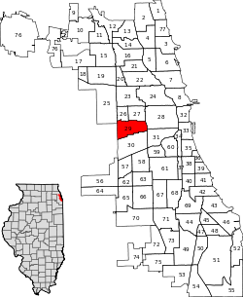

Slide 8
North Lawndale
South Lawndale
(aka ‘Little Village’)
96% African-American
Poor
19 heat-related deaths (40 per 100,000)
85% Latino
Poor
3 heat-related deaths (less than 4 per 100,000)

Slide 9
It must be racial difference!
Latino ‘metabolism’ is more suited to hot weather

Slide 10
It must be cultural difference!
Family ties are closer among Latinos due to their ‘culture’

Slide 11
Why isn’t the difference in mortality (excess death) due to race or culture?
What makes those arguments unpersuasive?

Slide 12
Social environment and ecology
Ecological characteristics:
“spatial and temporal relations of human beings as affected by the selective, distributive, and accomodative forces of the environment" (90)
Social morphology
“the material substratum of societies, that is, the form they assume in settling across the land, the volume and density of their population, the manner in which it is distributed as well as the ensemble of things that serve as the basis for collective life" (90).

Slide 13
“The social ecology of a community area is the foundation for local social life, the soil out of which social networks grow and develop, or, alternatively, wither and devolve.”

Slide 14
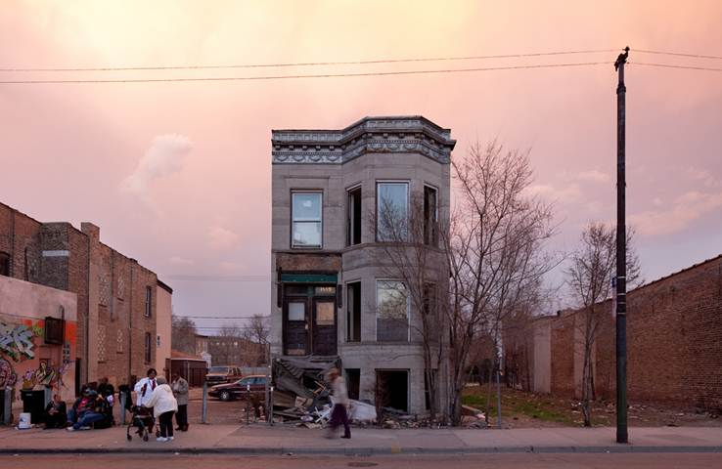

Slide 15
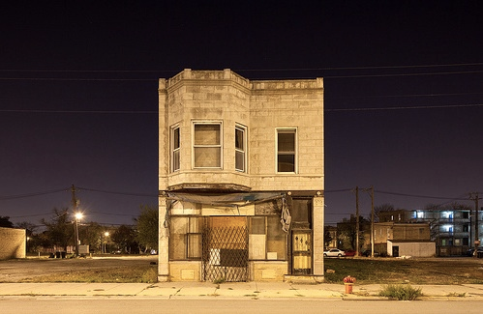

Slide 16
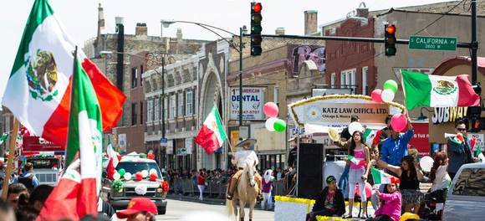

Slide 17
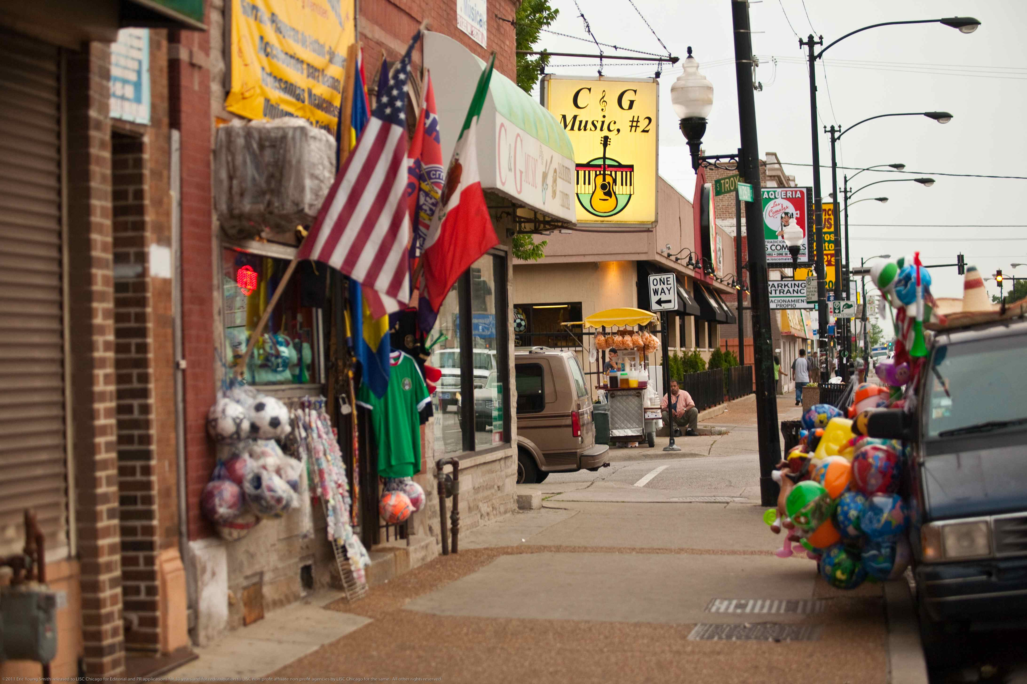

Slide 18
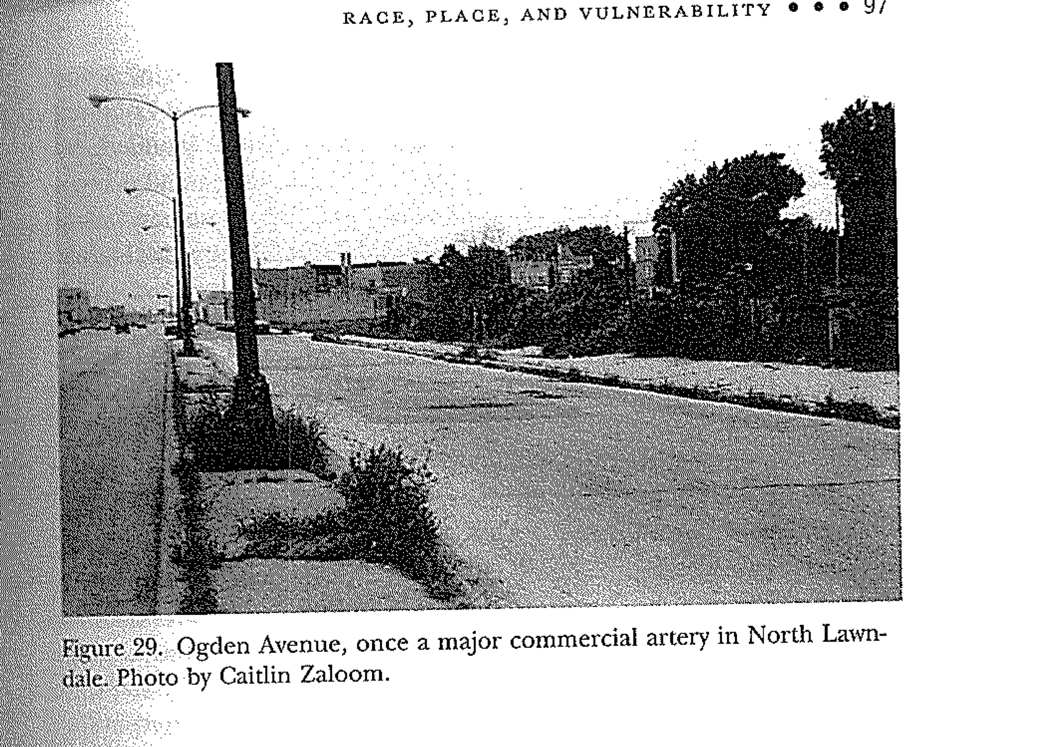

Slide 19
Identify one aspect of social ecology and morphology that differs between North and South Lawndale

Slide 20
Social environment and ecology
Ecological characteristics:
“spatial and temporal relations of human beings as affected by the selective, distributive, and accommodative forces of the environment" (90)
Social morphology:
“the material substratum of societies, that is, the form they assume in settling across the land, the volume and density of their population, the manner in which it is distributed as well as the ensemble of things that serve as the basis for collective life" (90).

Slide 21
Historical roots of the social ecology

Slide 22
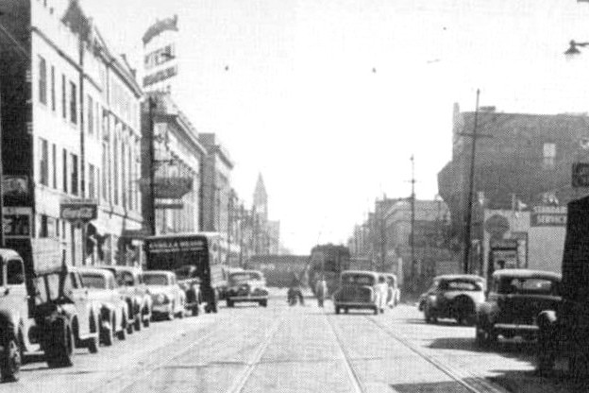

Slide 23
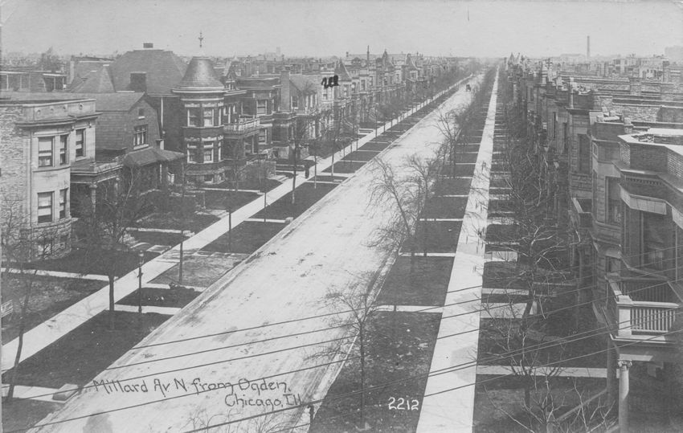

Slide 24
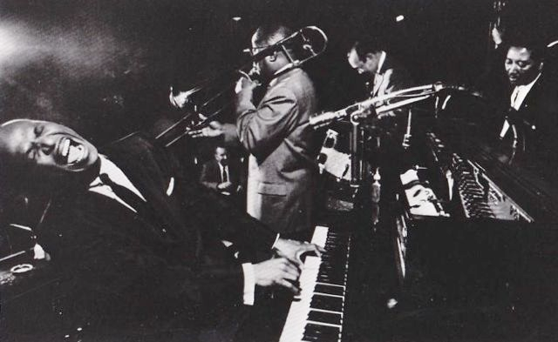

Slide 25
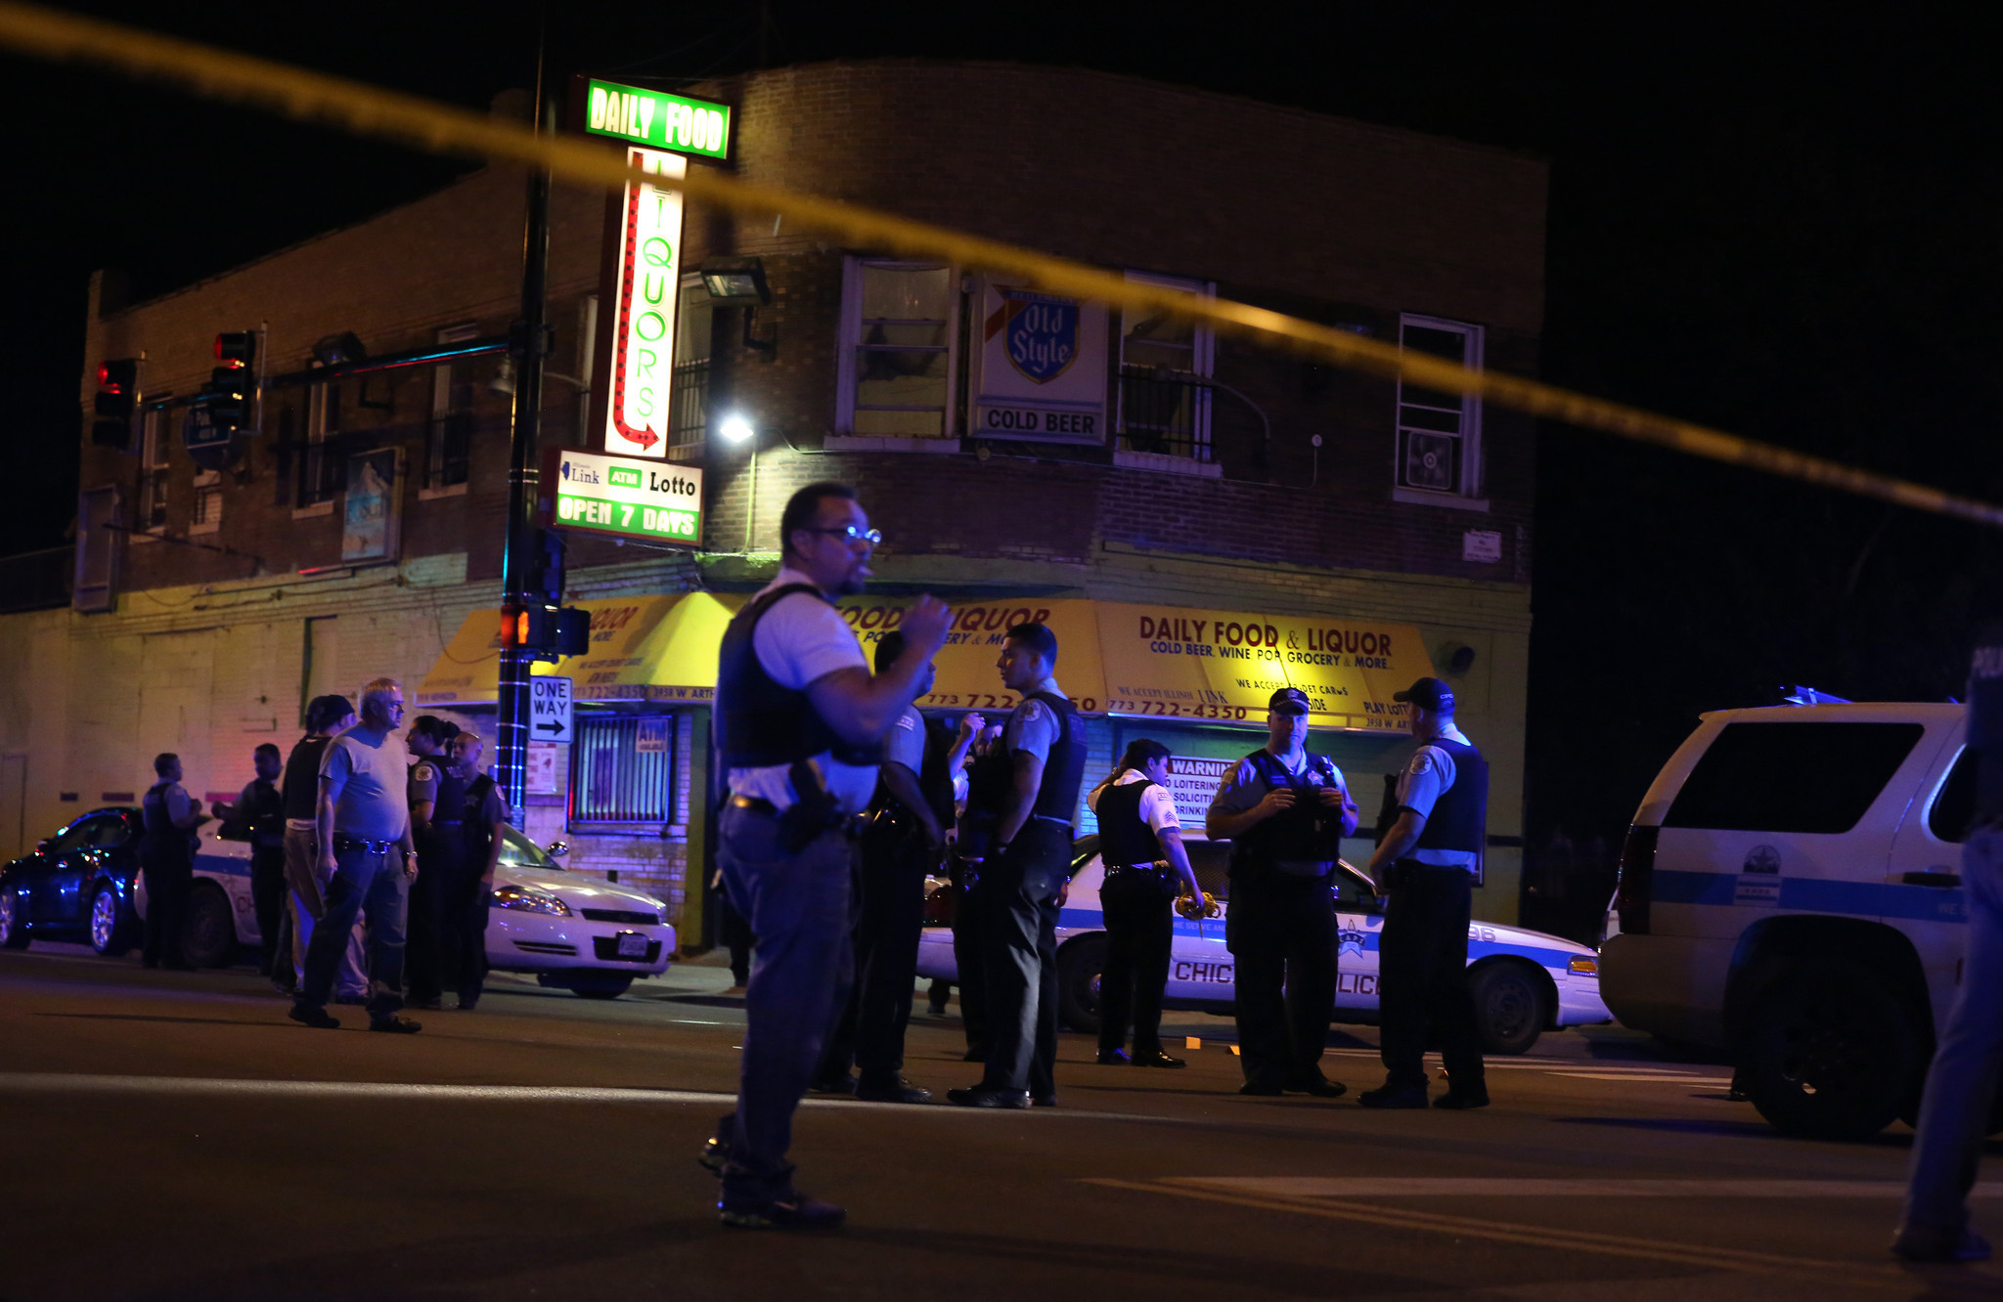
Why so much crime?

Slide 26
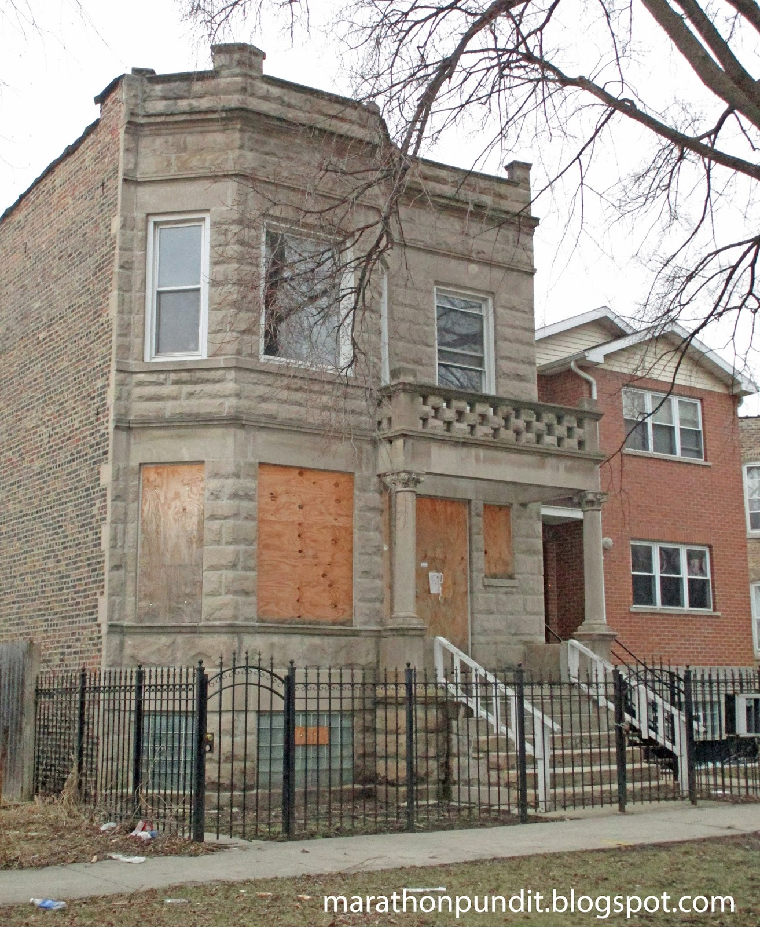
North Lawndale’s decline
"By 1970, 75 per cent of the businesses that had been in the area in 1950 were gone, and in the 1980s and early 1990s North Lawndale experienced little economic growth."

Slide 27
We have gone beyond linear explanations in terms of isolated risk factors (population risk)
We have gone beyond explanations due to race (biology) or culture
We have also gone beyond simple explanations due to poverty alone
The experience of poverty, and whether it creates vulnerability to disasters, varies according to social environment and ecology

Slide 28
Discussion: what then is the ‘social’ in ‘social autopsy of disaster’?

